Slide 1



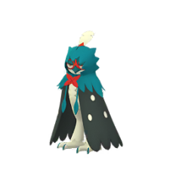
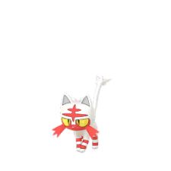
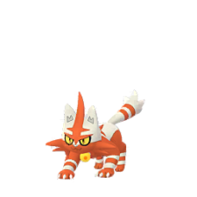
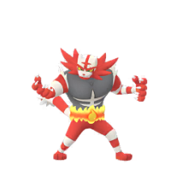

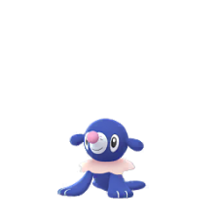
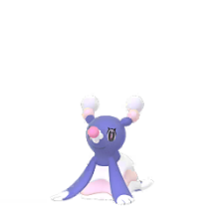
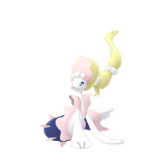
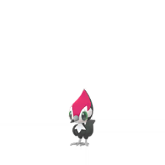
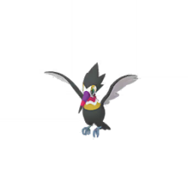
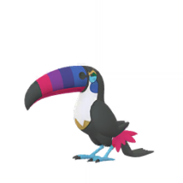
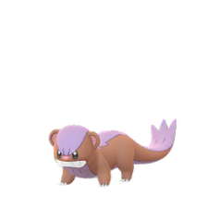
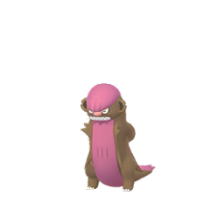
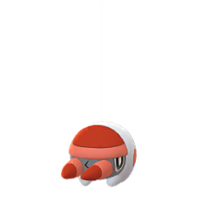
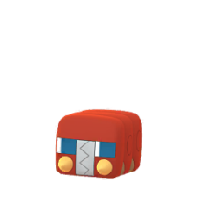
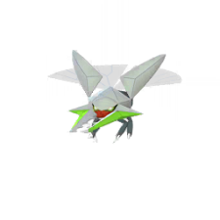
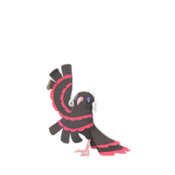
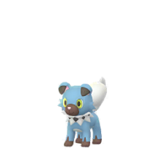
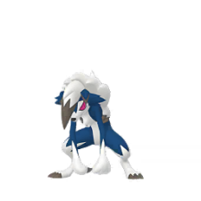
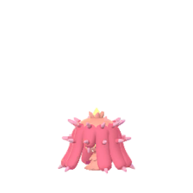
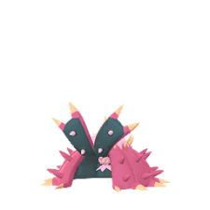
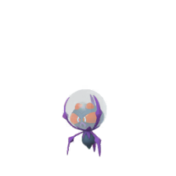
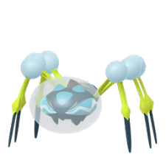
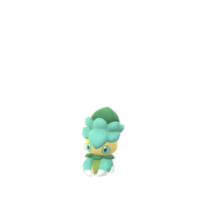
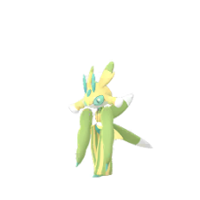

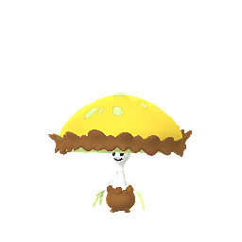
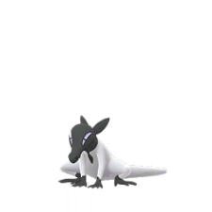
Pokemon Go : Shiny Check List
Generation 7 ( Alola )
Rowlet
Dartrix
Decidueye
Litten
Torracat
Incineroar
Popplio
Brionne
Primarina
Pikipek
Trumbeak
Toucannon
Yungoos
Gumshoos
Grubbin
Charjabug
Vikavolt
Crabrawler
NO SPRITE
Crabominable
Oricorio
Cutiefly
Ribombee
Rockruff
Lycanroc
NO SPRITE
More On Page 3
NO SPRITE
NO SPRITE
More On Page 4
Wishiwashi
Mareanie
Toxapex
Mudbray
Mudsdale
Dewpider
More On Page 3
NO SPRITE
NO SPRITE
NO SPRITE
Araquanid
Fomantis
Lurantis
Morelull
Shiinotic
Salandit
Page 1 of 4

Slide 2
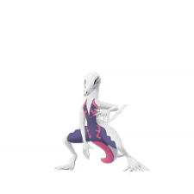


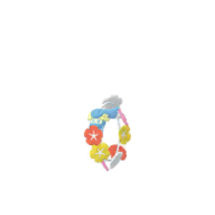

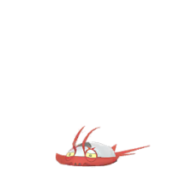
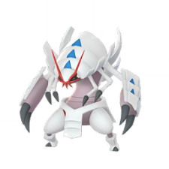

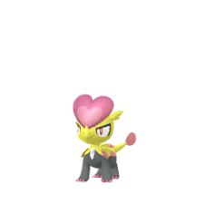
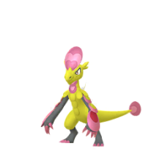
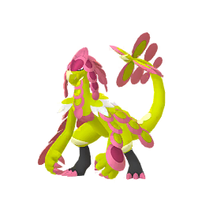
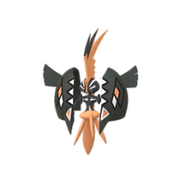
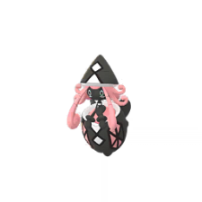
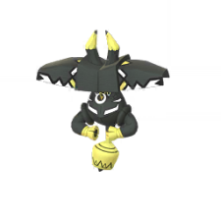
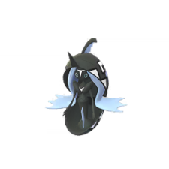
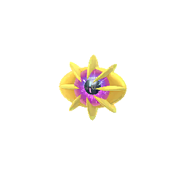
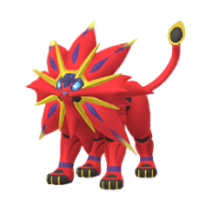

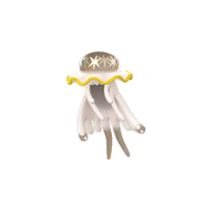
Pokemon Go : Shiny Check List
Generation 7 ( Alola )
Salazzle
Stufful
Bewear
Bounsweet
Steenee
Tsareena
NO SPRITE
NO SPRITE
NO SPRITE
Comfey
Oranguru
Passimian
Wimpod
Golisopod
Sandygast
NO SPRITE
NO SPRITE
Palossand
Pyukumuku
Type: Null
Silvally
Minior
Komala
NO SPRITE
NO SPRITE
NO SPRITE
More On Page 4
More On Page 4
NO SPRITE
NO SPRITE
NO SPRITE
Turtonator
Togedemaru
Mimikyu
Bruxish
Drampa
Dhelmise
NO SPRITE
More On Page 4
NO SPRITE
NO SPRITE
NO SPRITE
NO SPRITE
Jangmo-o
Hakamo-o
Kommo-o
Tapu Koko
Tapu Lele
Tapu Bulu
Tapu Fini
Cosmog
Cosmoem
Solgaleo
Lunala
Nihilego
NO SPRITE
Page 2 of 4

Slide 3
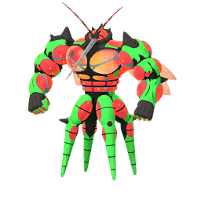
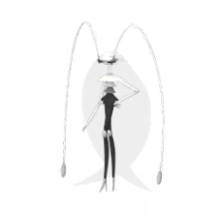
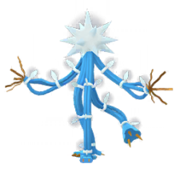
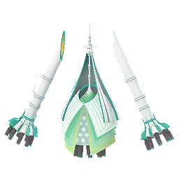
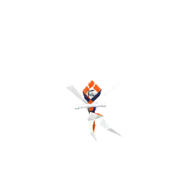
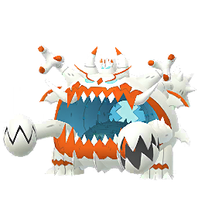

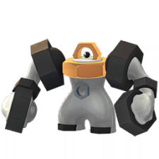
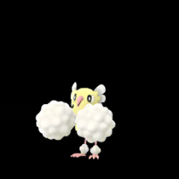
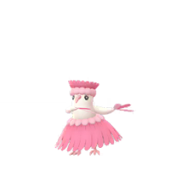
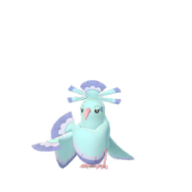
Pokemon Go : Shiny Check List
Generation 7 ( Alola ) & Hisuian
Buzzwole
Pheromosa
Xurkitree
Celesteela
Kartana
Guzzlord
Necrozma
Magearna
Marshadow
Poipole
Naganadel
Stakataka
More On Page 4
NO SPRITE
NO SPRITE
NO SPRITE
NO SPRITE
NO SPRITE
NO SPRITE
Blacephalon
Zeraora
Meltan
Melmetal
NO SPRITE
NO SPRITE
Wishiwashi Form’s
Hisuian
Solo
School
Decidueye
NO SPRITE
NO SPRITE
NO SPRITE
Oricorio Style
Baile
Pom-Pom
Pa’u
Sensu
Page 3 of 4

Slide 4

Pokemon Go : Shiny Check List
Generation 7 ( Alola )
Other’s
Minior Form’s
Necrozma
Meteor
Red Core
Normal
Dusk Mane
Dawn Wings
NO SPRITE
NO SPRITE
NO SPRITE
NO SPRITE
NO SPRITE
Lycanroc Form’s
Mimikyu Form’s
Midday
Midnight
Dusk
Disguised
Busted
NO SPRITE
NO SPRITE
NO SPRITE
Silvally Form’s
Normal
Bug
Dark
Dragon
Electric
Fairy
NO SPRITE
NO SPRITE
NO SPRITE
NO SPRITE
NO SPRITE
NO SPRITE
Fighting
Fire
Flying
Ghost
Grass
Ground
NO SPRITE
NO SPRITE
NO SPRITE
NO SPRITE
NO SPRITE
NO SPRITE
Ice
Poison
Psychic
Rock
Steel
Water
NO SPRITE
NO SPRITE
NO SPRITE
NO SPRITE
NO SPRITE
NO SPRITE
Page 4 of 4

